Slide 1


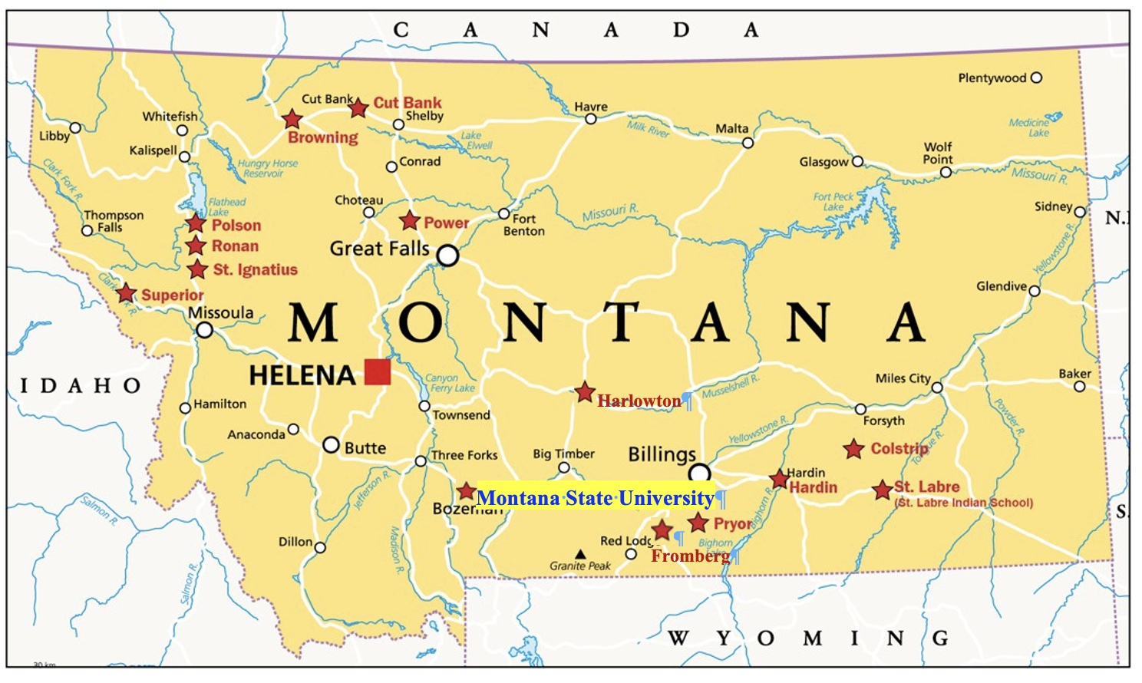
Rober Noyce Teacher Scholarship Program Track 3: Master Teaching Fellowships at Montana State University – Round 1
Rural and American Indian School Educators as Science, Technology, Engineering, and Mathematics Leaders (RAISE STEM Leaders)
https://www.montana.edu/smrc/noyce/
(NSF Award No. 2345186)
MSU Noyce Master Teaching Fellows
Town Hall Meeting & Reception Dinner
Tuesday, Aug. 4, 2026
4:30 – 6:30 PM
AIH 166, MSU

Slide 2
Robert Noyce Teacher Scholarship Program Track 3:
Master Teaching Fellowships
4:30 PM – 5:30 PM Town Hall Meeting
  Dr. Fenqjen Luo – Noyce Recruitment, Policy & Expectations
  Dr. Paul Gannon – Floating license and form
  Dr. Marcie Reuer – Rural Education
5:30 PM – 6:30 PM Reception Dinner

Slide 3
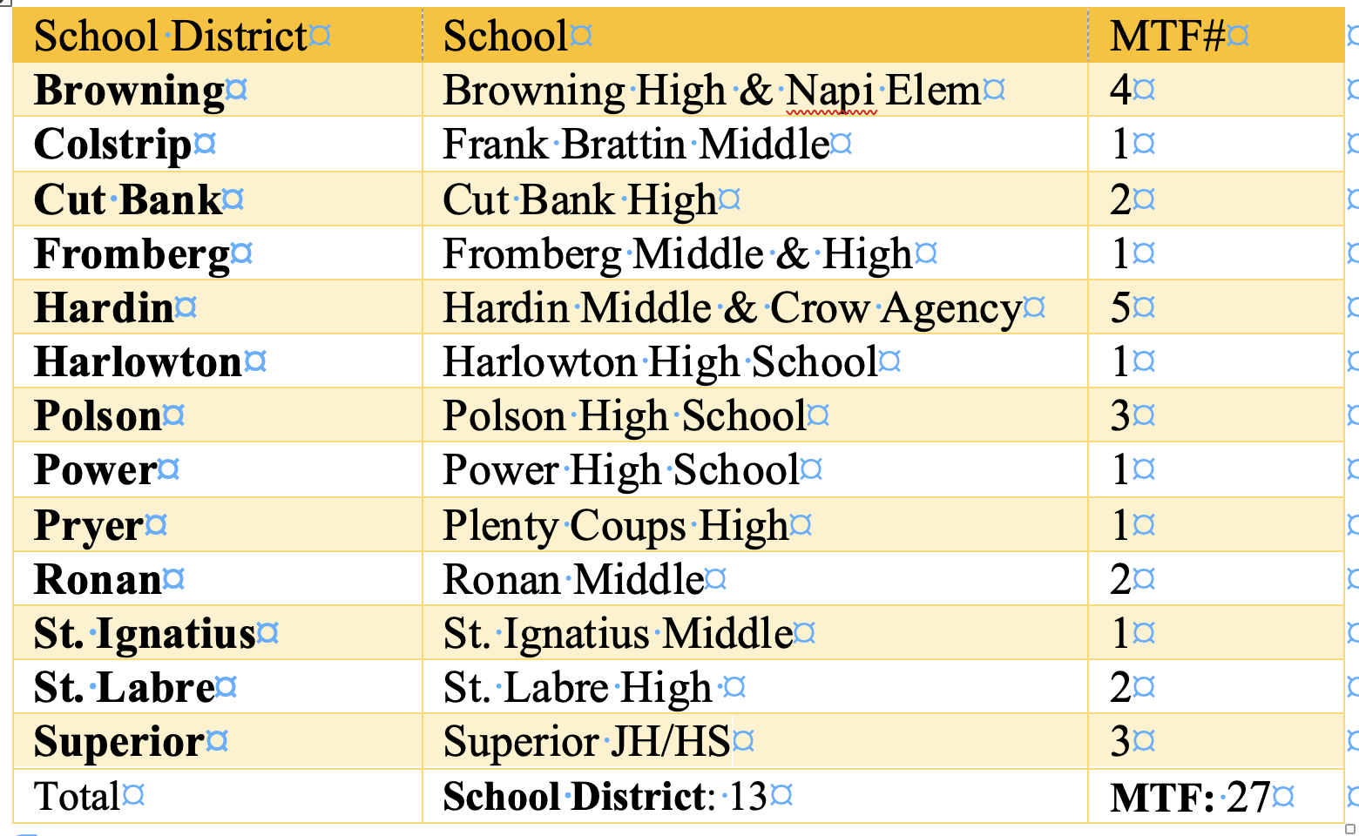
Recruitment:
27 — a perfect cube (3³)

Slide 4

Robert Noyce Teacher Scholarship Program Track 3:
Master Teaching Fellowships
Goals/Objectives
The project aims to empower in-service teachers to become exemplary STEM leaders who draw on locally relevant knowledge and community context to enhance academic rigor and increase student engagement in STEM education for all learners.
Enhancing the leadership competence of 27 certified, in-service STEM educators over five years.
Integrating funds of knowledge and Montana’s Indian Education for All (IEFA) into STEM curricula and instruction
Place-based education? Cultural responses teaching?
3. Empowering MTFs to lead formal and informal STEM activities tailored to increase student engagement in STEM learning.
Clear expectations?

Slide 5

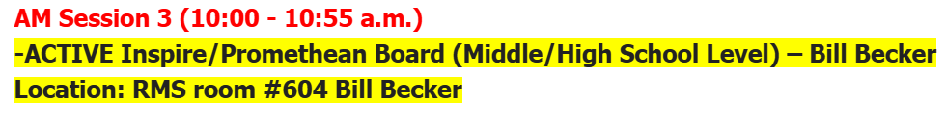
Goal 1: Engaging as a STEM Teacher Leader
  Short Reflection/Story (2-3 sentences):
  Math for All Teacher Leader - Worked with Polly as a facilitator/leader for the Math for All program being implemented in 4 local schools over the course of the full school year.
  Staff Inservice Presenter - Presented at teacher inservice day at my school on integrated some of our technology into our classroom.
  Support Files:

Slide 6

Goal 2: Integrating funds of knowledge and Montana’s Indian Education for All (IEFA) into STEM curriculum and instruction
  Short Reflection/Story (2-3 sentences):
My Flathead Nation Graphing Project has been a huge success. I turned it into a usable file for others and will be presenting is at this year’s STEM Summer Institute.
  Support Files:

Slide 7
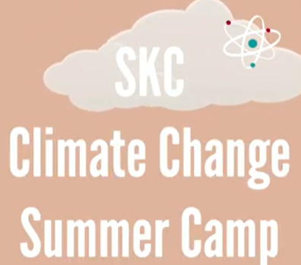
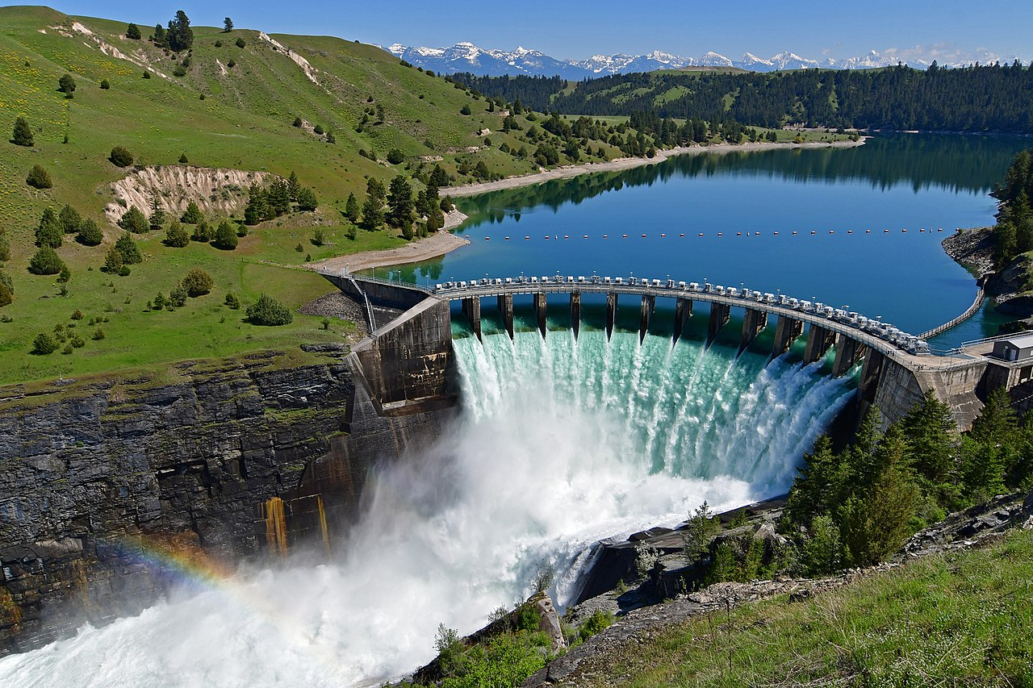
Goal 3: Designing and facilitating formal and informal STEM activities
  Short Reflection/Story (2-3 sentences):
I also developed and used several lessons via a summer partnership with Salish Kootenai College and the Flathead Valley Boys & Girls Clubs of Ronan, Polson and Mission.
Developed a Cross Curricular Thematic Unit Centered on the SKQ Dam on the Flathead Reservation through Polar STEAM Fellowship. PROJECT DESCRIPTION and FELLOWSHIP BIO.
  Support Files:

Slide 8
What training and professional development activities have you participated in over the past year?
Trainings & Fellowships:
NCTM Regional Conference in New Orleans - March 16-18, 2026 CERTIFICATE
Public Health in Schools Teacher Workshop - University of Montana - May 21, 2026 CERTIFICATE
Clean Energies Fellows: Pacific Northwest Power Grid Cohort - 2024-2025 School Year CERTIFICATE
Polar STEAM Fellowship - Oregon St. 2025-2026 School Year PROJECT DESCRIPTION & FELLOWSHIP BIO
Indigitize Generation AI Community of Practice - Online - Spring 2026 CERTIFICATE
aiEDU Trail Blazers Fellowship - Hybrid Online & Polson, MT - Fall 2025 CERTIFICATE
Tribal PIR Inservice Day at Salish Kootenai College - September 15, 2025 CERTIFICATE
To Learn a New Way: Indian Boarding School Curriculum Series- December 16, 2025 and January 7, 2026 Salish Kootenai College - CERTFICATE 1 & CERTIFICATE 2
STEM Summer Institute - Montana State University Bozeman - July 28-30, 2025 CERTIFICATE

Slide 9
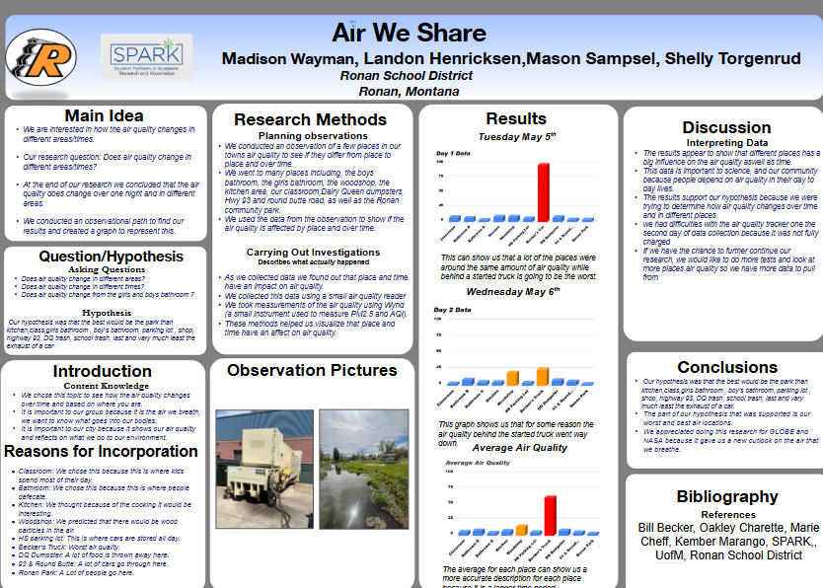

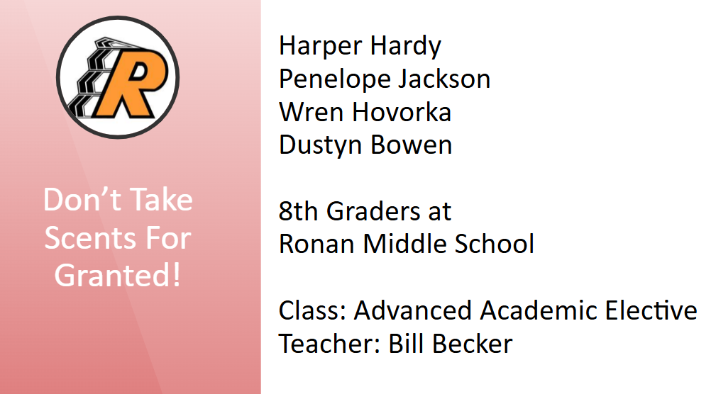
What awards, honors, special accomplishments, or unique experiences did you have over the past year that haven't been mentioned in the previous slides?
Ronan Middle School Academic Bowl Team Coach
1st Place Team - Lake County Academic Bowl Season NEWSPAPER
Ronan Middle School MATHCOUNTS Team Coach
4th Place Team - MATHCOUNTS Kalispell Chapter (3rd Place Individual)
LIVE with Po-Shen Loh Scholarship Recipients
Seven 6th Graders participated in the Fall 2025 Cohort
Featured on GLOBE Alumni Engagement Series
FULL RECORDING ENGAGING ALUMNI (BECKER)
Teaching Lab Studio Research Study Partner - Tangle and Thrive
PROGRAM DESCRIPTION
SPARK Research Symposium at University of Montana
2 Research Teams Presented their Research Projects at U of M

Slide 10
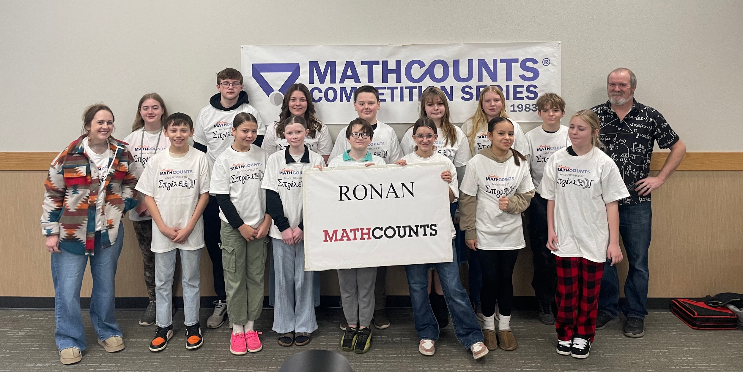
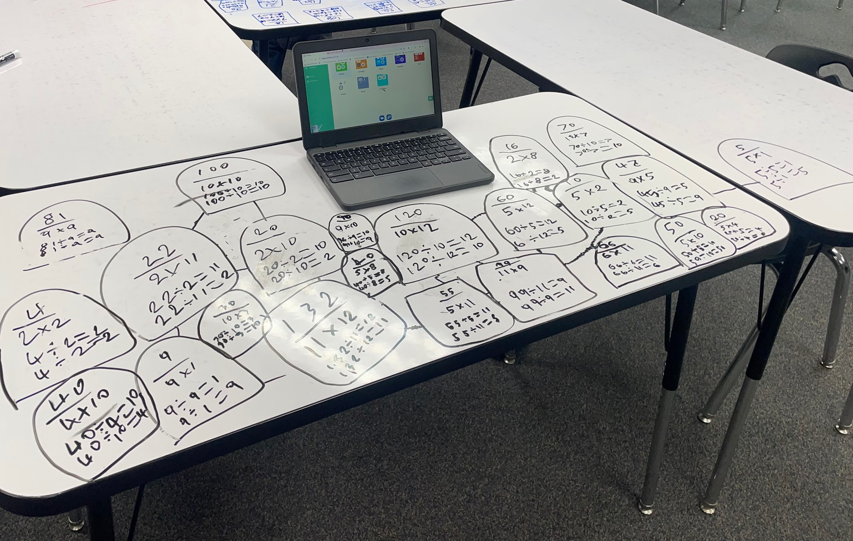
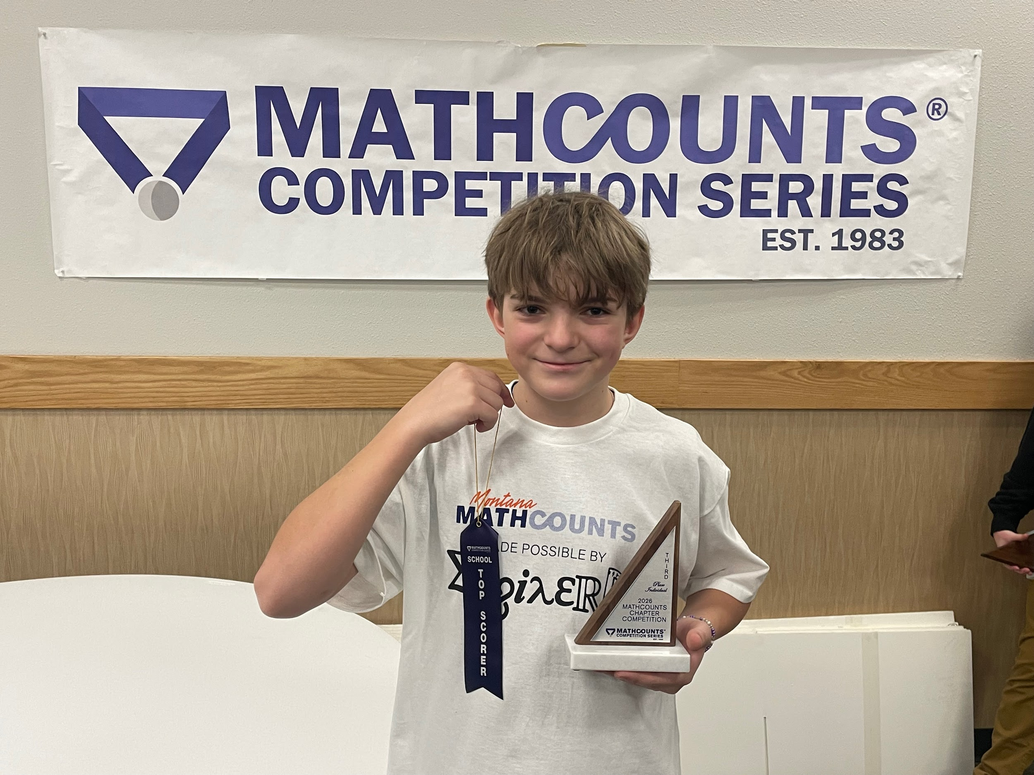
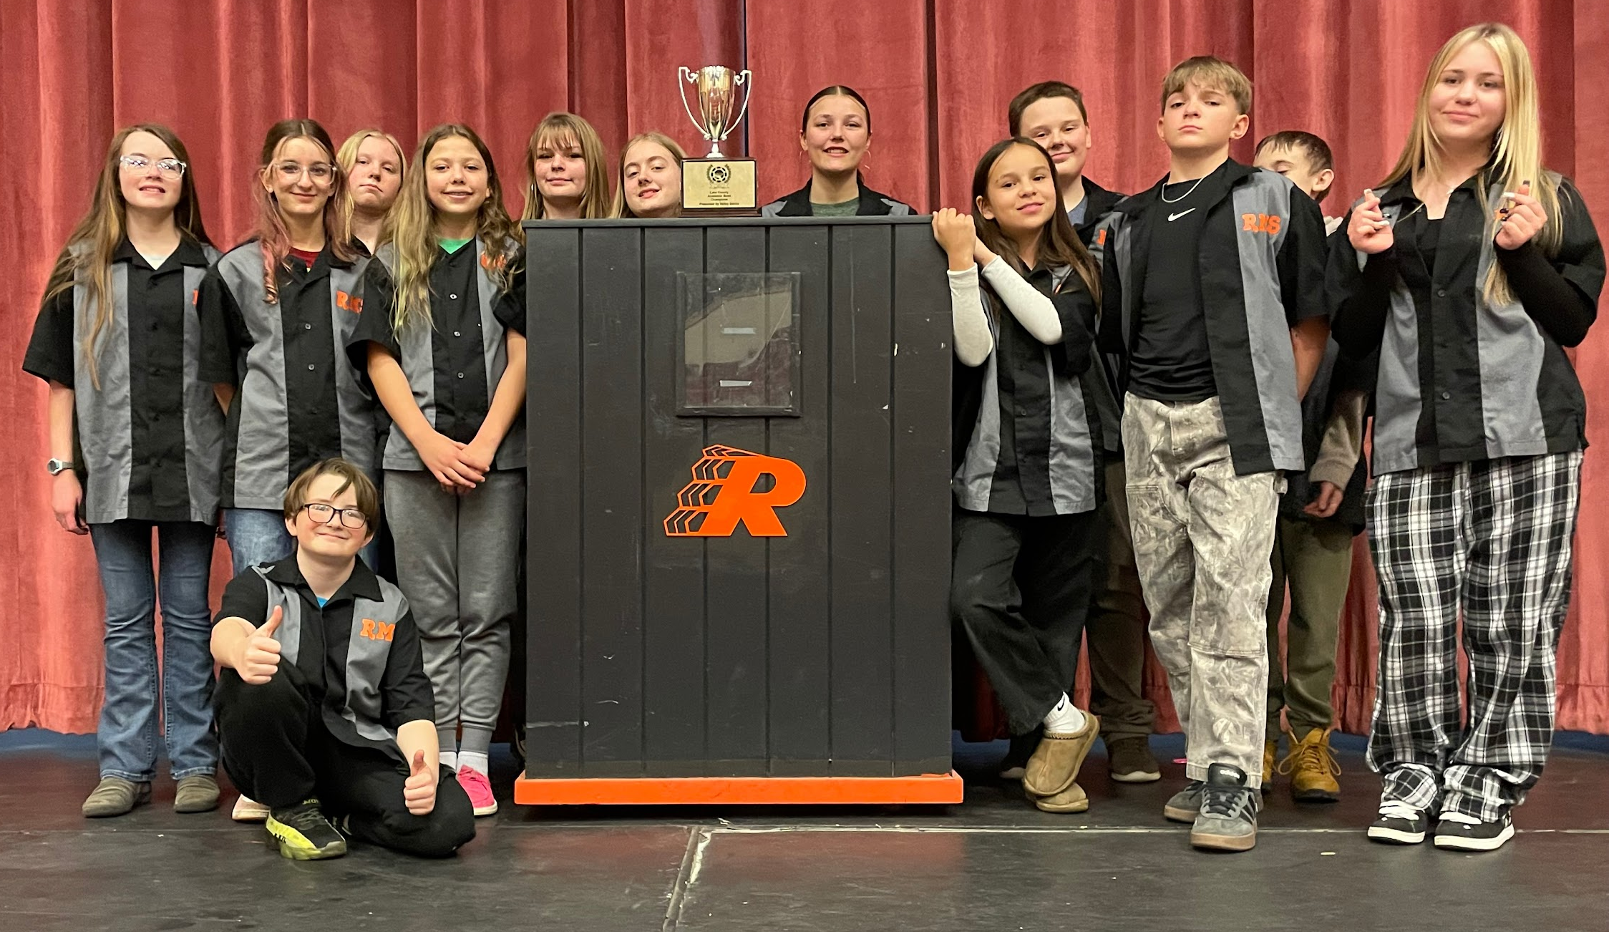
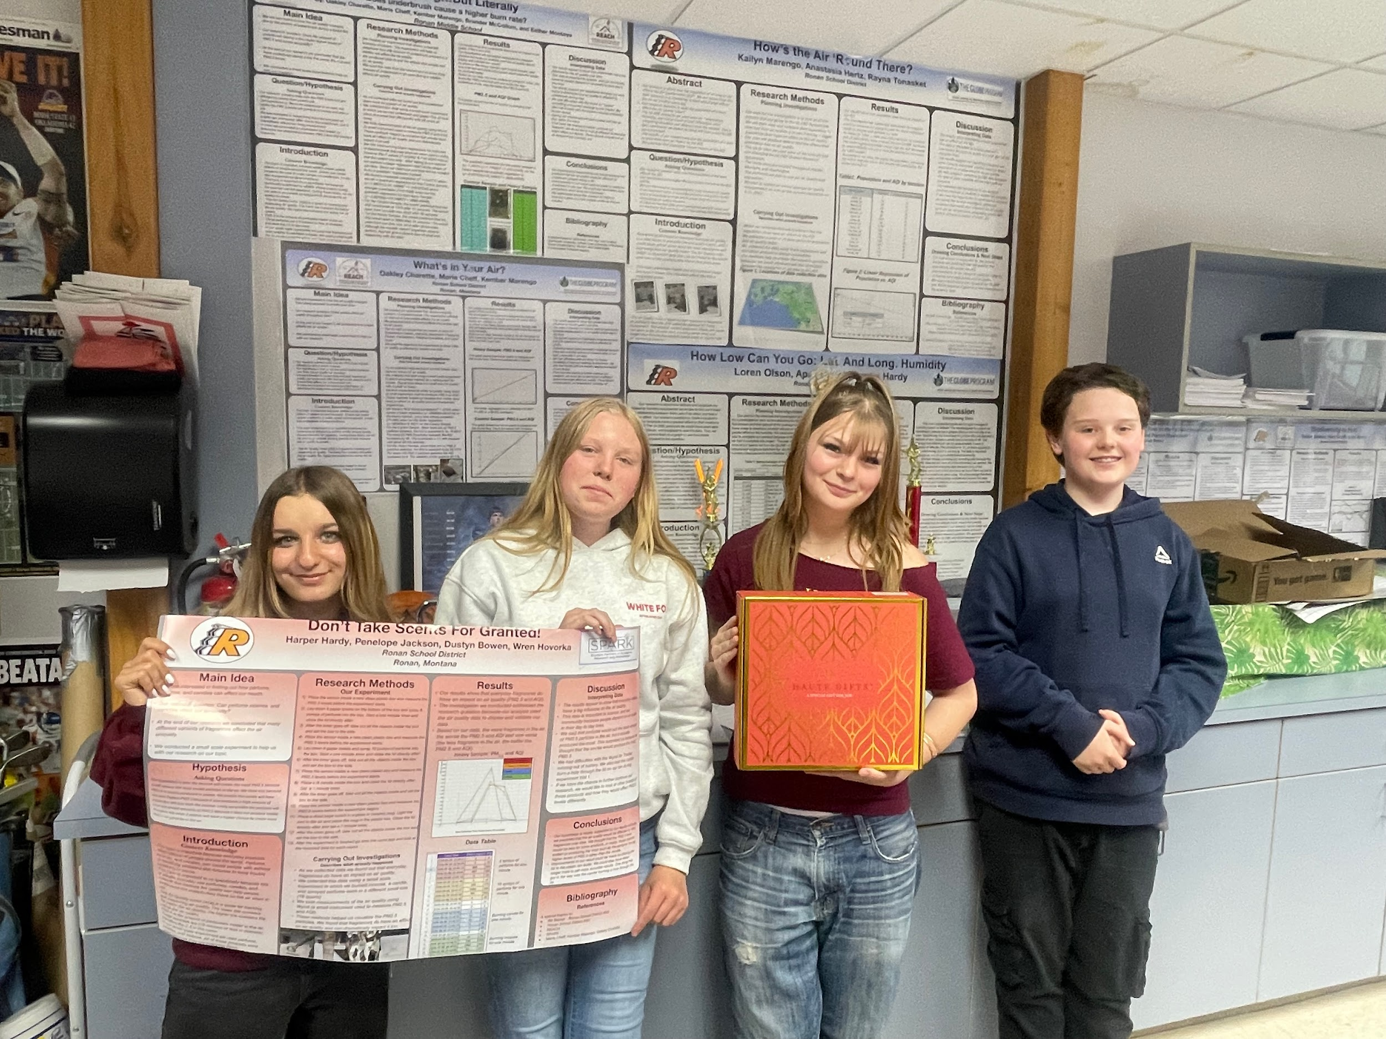
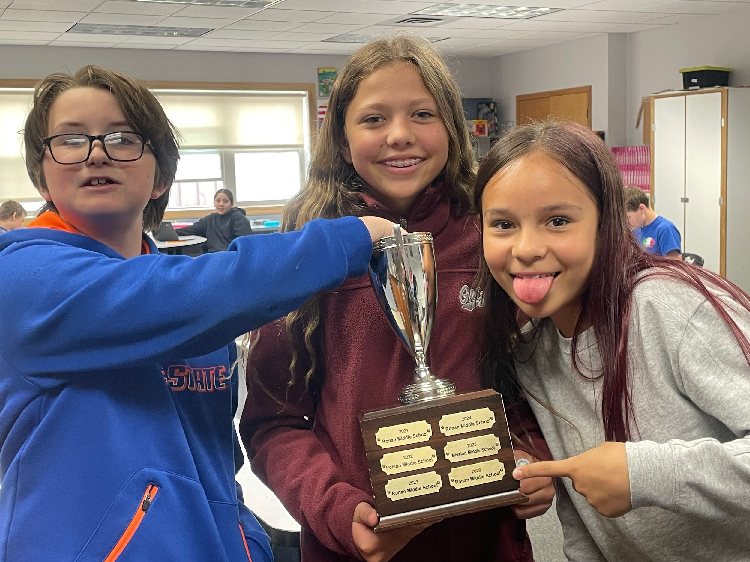
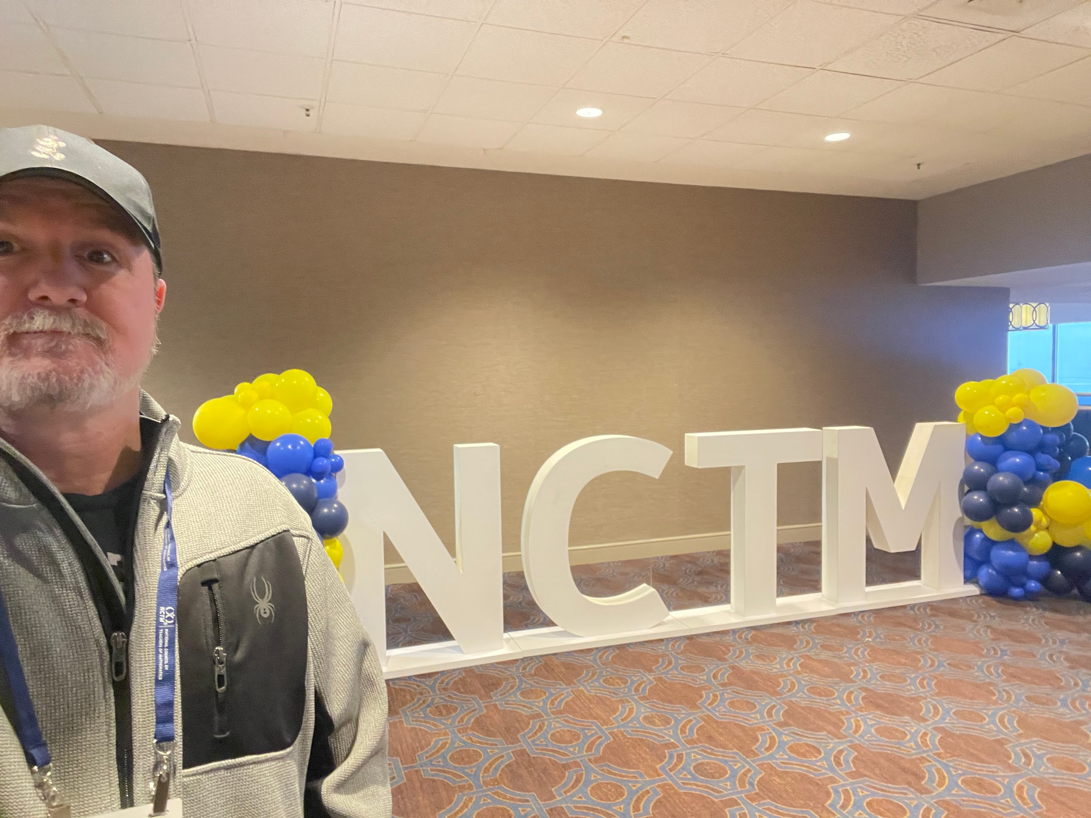

Slide 11
Robert Noyce Scholarship Program:
Master Teaching Fellowship Track
“The term “fellowship” means funds awarded: …in the NSF Master Teaching Fellowships Track to a STEM teacher (in which case the funds are also referred to as a salary supplement).” (p.7)
Source: Robert Noyce Teacher Scholarship Program Solicitation in 2023

Slide 12
Robert Noyce Scholarship Program:
Master Teaching Fellowship Track
“MTFs with elementary certification or licensure should teach mathematics and/or science for at least 50% of their classroom teaching responsibilities” (p. 15)
Source: Robert Noyce Teacher Scholarship Program Solicitation in 2023
Note. MSU Noyce MTF program will verify the status of your course teaching responsibilities every year during your fellowship period.

Slide 13
Amount and Duration of Salary Supplements
(Track 3: MTF)
“…While participating in the program and teaching in a high-need LEA, MTFs must receive a salary supplement of $10,000 or more per year for each year of the five-year teaching commitment period (for those possessing a master’s degree) or each of the four-year teaching commitment (for those possessing only a bachelor's degree) after earning the master's degree.” (p.15)
Source: Robert Noyce Teacher Scholarship Program Solicitation in 2023
MSU Cohort 1 Noyce Master Teaching Fellows: Fellows possess a master’s degree
MSU Cohort 2 Noyce Master Teaching Fellows: Fellows only possess a bachelor’s degree in Education or STEM

Slide 14
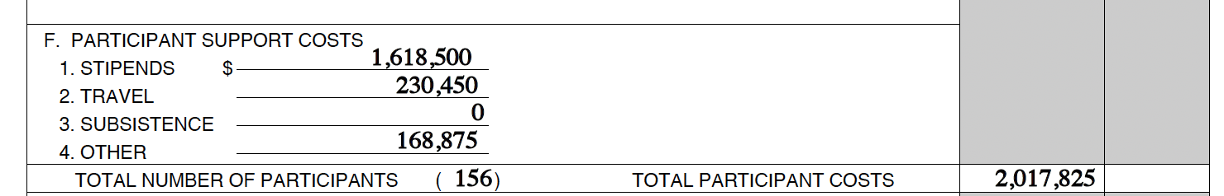

MSU Noyce MTF Budget
Total Awarded Budget: $2,999,688
Total Awarded Budget for Participants: $2,017,856
Scholarships (tuitions included)
Need to meet 40/60 Requirements

Slide 15
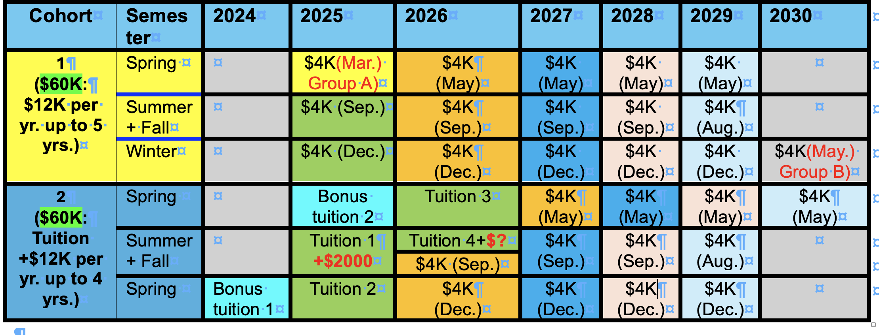
Projected Noyce Paycheck/Stipend Calendar
Q: Payment schedule inconsistencies?
+$2000
NOTE:
The MSU Noyce program will try to process your paycheck/stipend by the end of the scheduled month. However, it could take you one or two more months to receive it.
The term “fellowship” means funds awarded …in the NSF Master Teaching Fellowships Track to a STEM teacher (in which case the funds are also referred o as a salary supplement)(p.8).

Slide 16
Projected Noyce Paycheck/Stipend Calendar
MTFs is funded by Rober Noyce Teacher Scholarship Program
“Scholarships are not considered taxable income or loans during the period of the scholarship support.” “Stipends are not considered taxable income or loans during the period of the stipend support.”
  Source: Robert Noyce Teacher Scholarship Program Solicitation in 2023
Unclear tax documentation ?

Slide 17
Recipient Obligations
An institution receiving a grant under Track 1: S &S, Track 2: TF, or Track 3: MTF agrees to:
ensure that Noyce recipients accept the terms of the scholarship, stipend, or fellowship and that recipients provide annual certification of employment and updated contact information;
supply to NSF relevant statistical and demographic data on Noyce recipients
cooperate with NSF third-party project monitoring that will require annual data collection; and
monitor, track, and report on the compliance of Noyce recipients with their teaching service commitments.
collect and report data on recipients’ persistence as classroom teachers beyond their service commitments; the reporting requirement may extend for up to 12 years following the end date of the award and submission of the final project report.

Slide 18
Recipient Obligations
“…the recipient will be required to repay all or a portion of the scholarship, stipend, or fellowship, if the recipient:
1. fails to maintain an acceptable level of academic standing in the program in which the individual is enrolled;
2. is dismissed from the program or institution for disciplinary reasons;
3. withdraws from the institution or program before completion of program requirements;
4. declares that the teaching service commitment will not be fulfilled; or
5. fails to fulfill the teaching service commitment.
If such circumstances occur before the completion of one year of the teaching service commitment under any track, the total amount of scholarship, stipend, or fellowship received by the individual must be repaid.
If the circumstance occurs after the completion of one year of the teaching service commitment, the amount to be repaid will be as follows:
Track 3: MTF – “one-half of the total amount of salary supplements received, including fellowship support in year one for MTFs without master's degrees.”

Slide 19
Cash Repayment Obligation
The following description could be included in the MSU agreement projected to be signed in October for a Cohort 2 fellow:
“The full remaining balance of the Scholarship Loan and Stipend will become immediately due and payable in accordance with the terms of the Promissory Note and this Agreement, if the Fellow:
fails to successfully complete the degree requirements of the Master Science in Science Program in the University’s College of Letters and Science; or
resigns or is terminated from employment by the School District.

Slide 20
MSU Noyce Fellowship Agreement & Promissory Note I.B: Fulfill Teaching Service Commitment and Leadership Role
Serving as a full-time STEM teacher in a high-need LEA for a total of five years (Note. Teacher Retention).
Assuming a teacher leadership role within the school or high-need LEA where the MTF is employed, while meeting the teaching service commitment determined by the school and Montana State University, in addition to regular classroom responsibilities. Examples of such leadership activities include mentoring, participating in curriculum development, assisting with the planning and implementation of professional development experiences, and contributing to pre-service teacher education.
Taking on a leadership role in a regional, state, or national professional organization or development event as a lead person at least twice during the five-year fellowship term. Examples of such leadership activities include serving as a board member of a regional, state, or national professional education organization or leading a professional development.

Slide 21
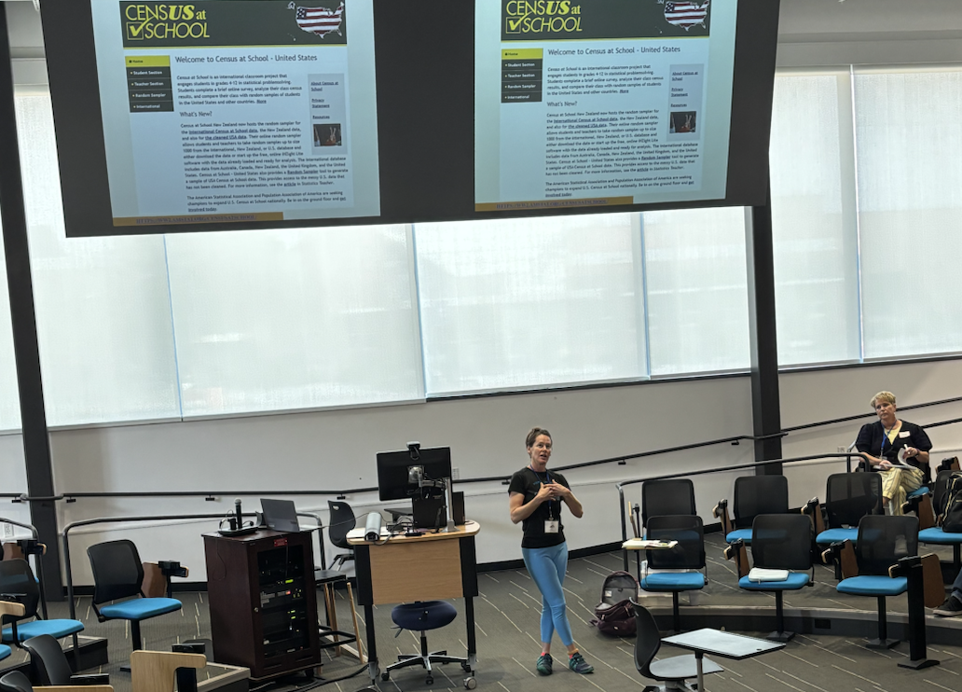
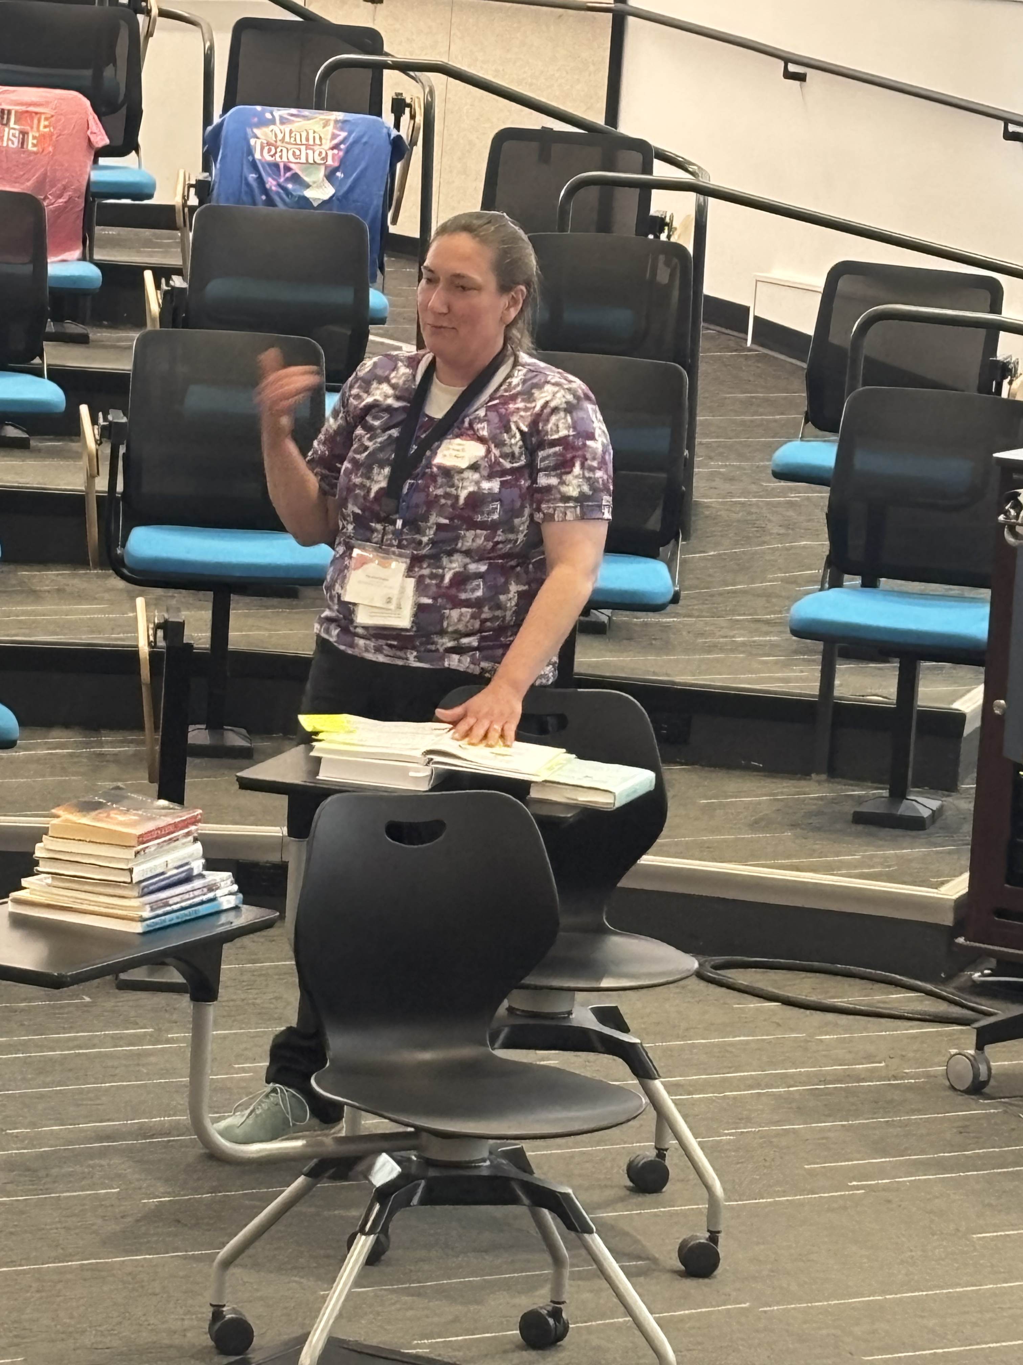
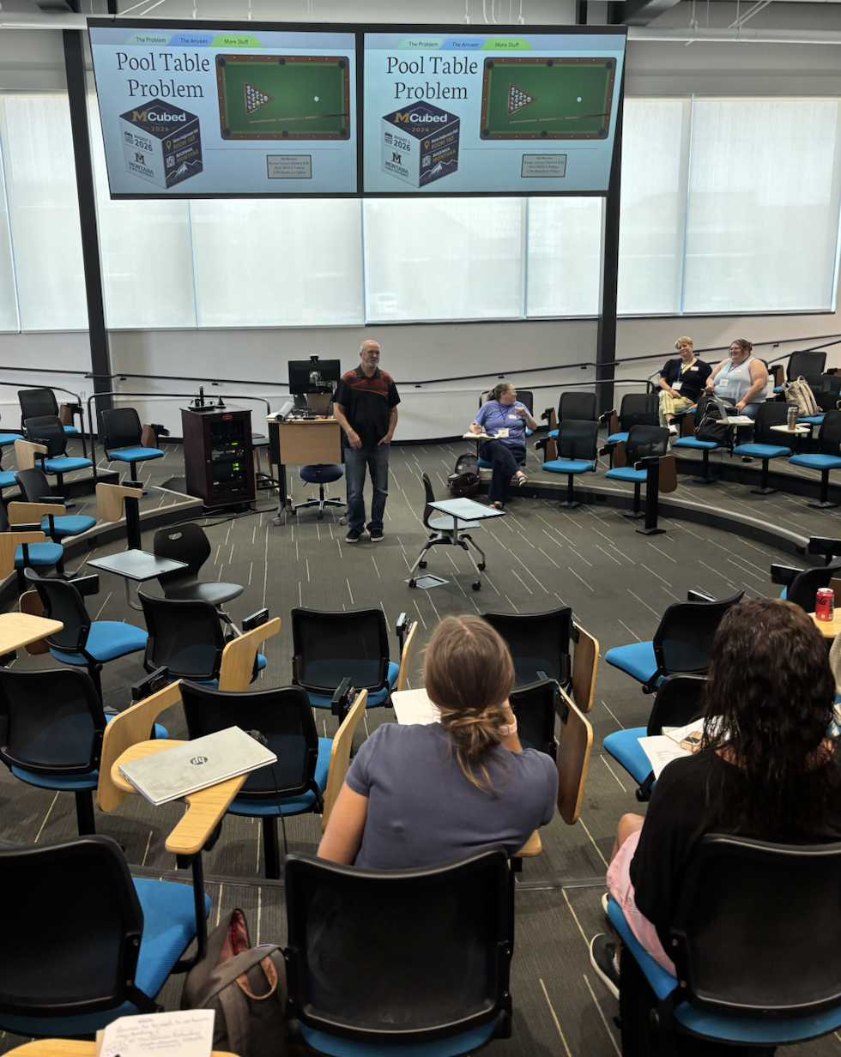
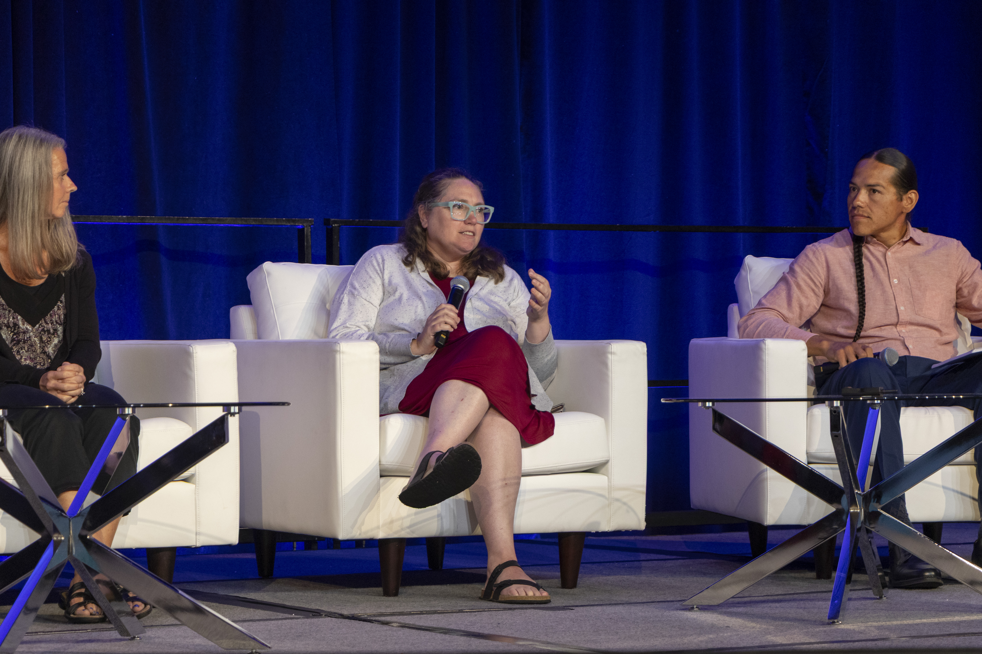
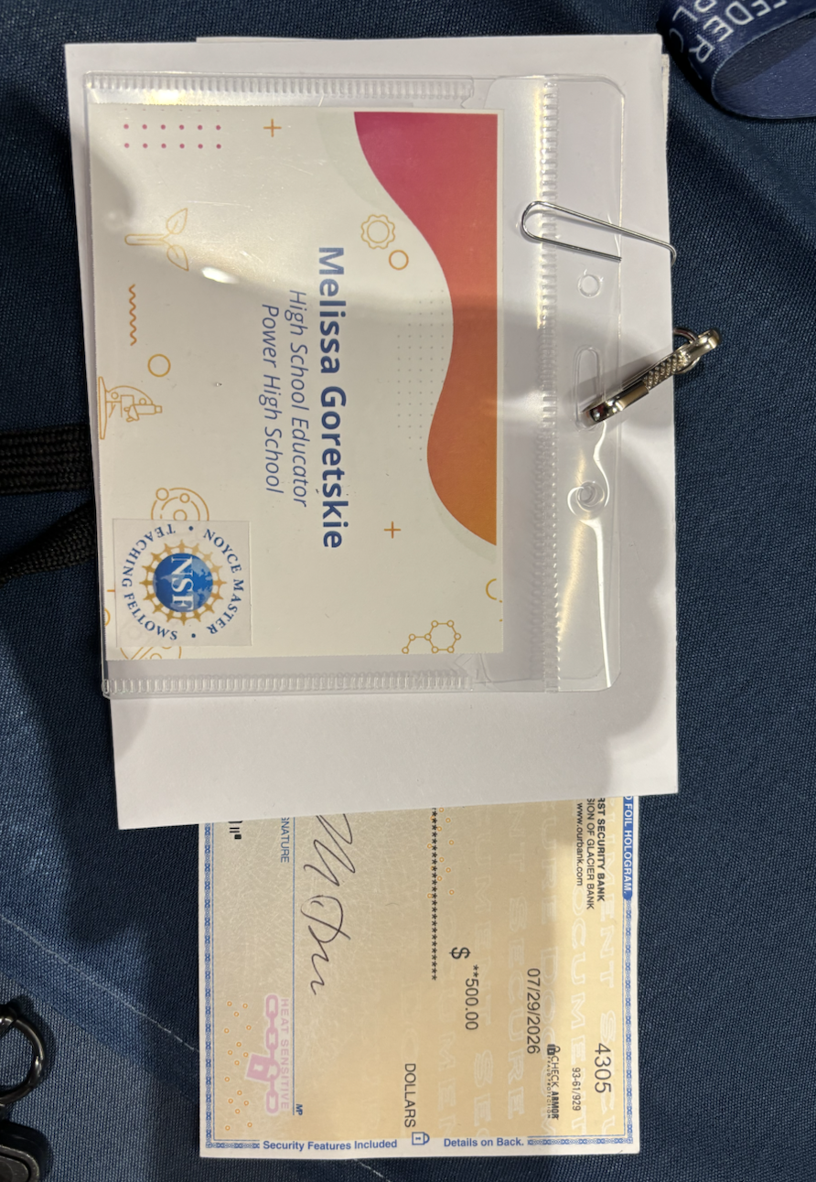
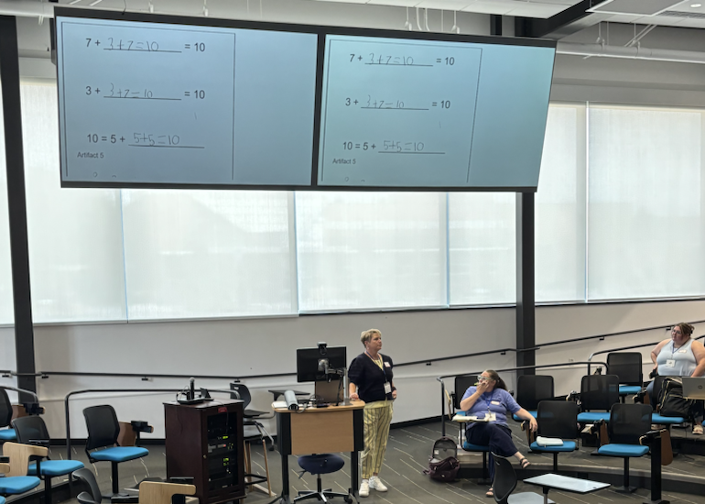
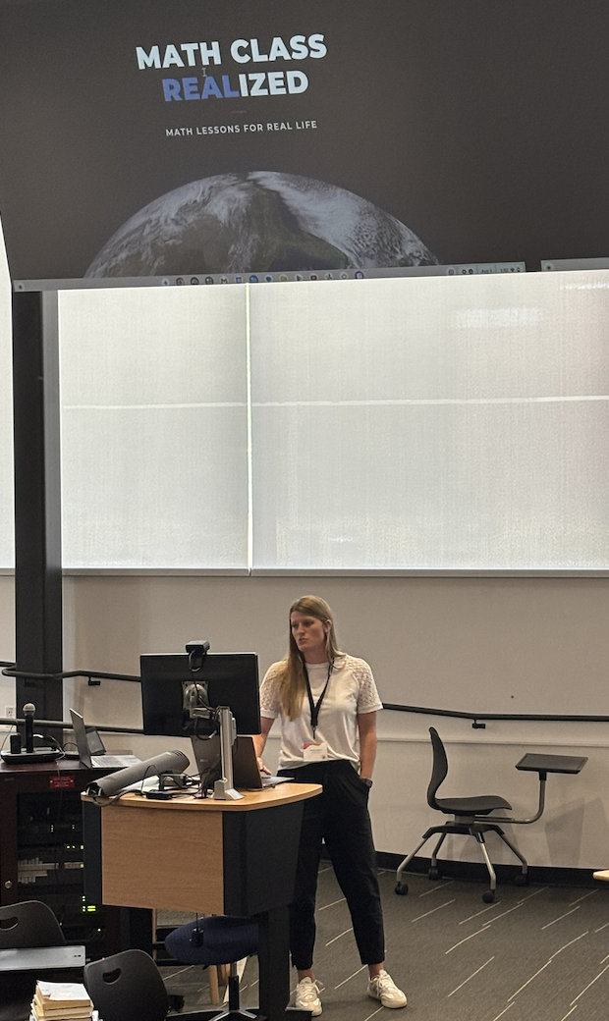
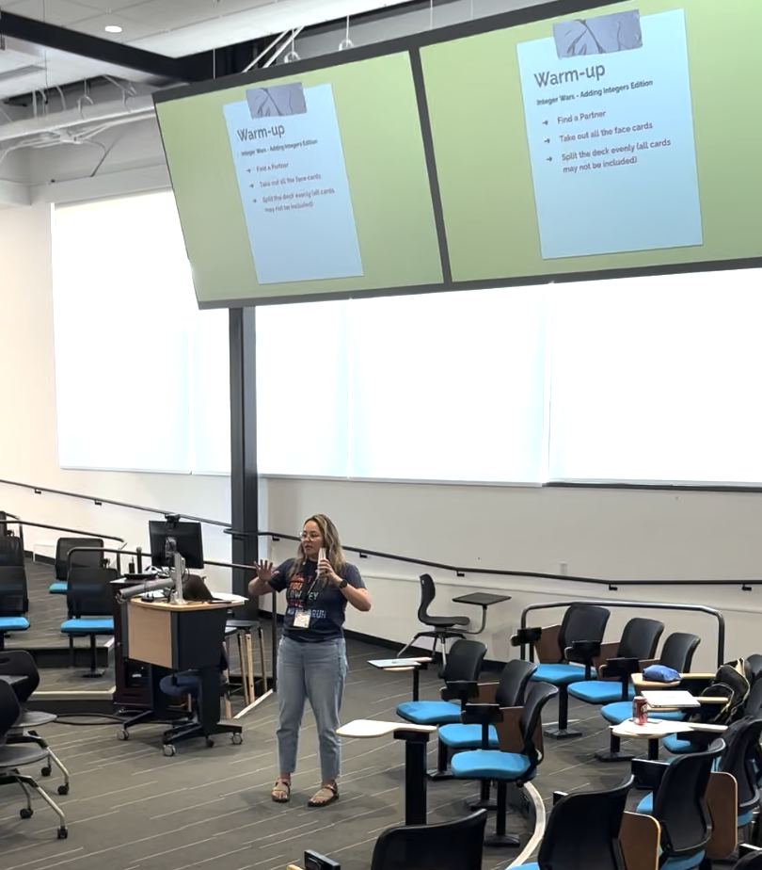
STEM Leaders

Slide 22
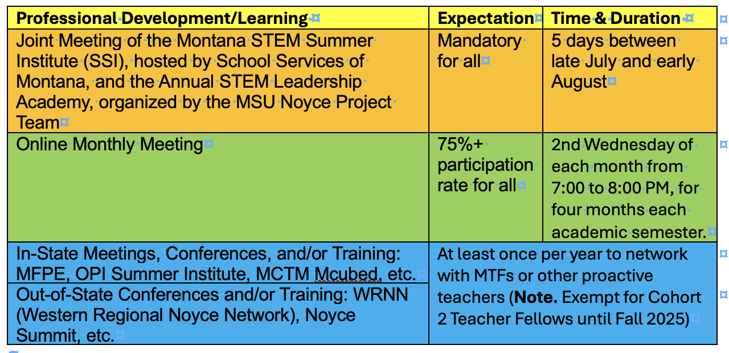
MSU Noyce Fellowship Agreement & Promissory Note I.C: Professional Development Growth

Slide 23
Monthly Meetings (Online)
Fall 2026 – Discussion and Planning (Friday, August 7)
MTFs sought greater autonomy in shaping their own learning agendas.
MTFs will take turns serving as leaders for the monthly meetings.

Slide 24
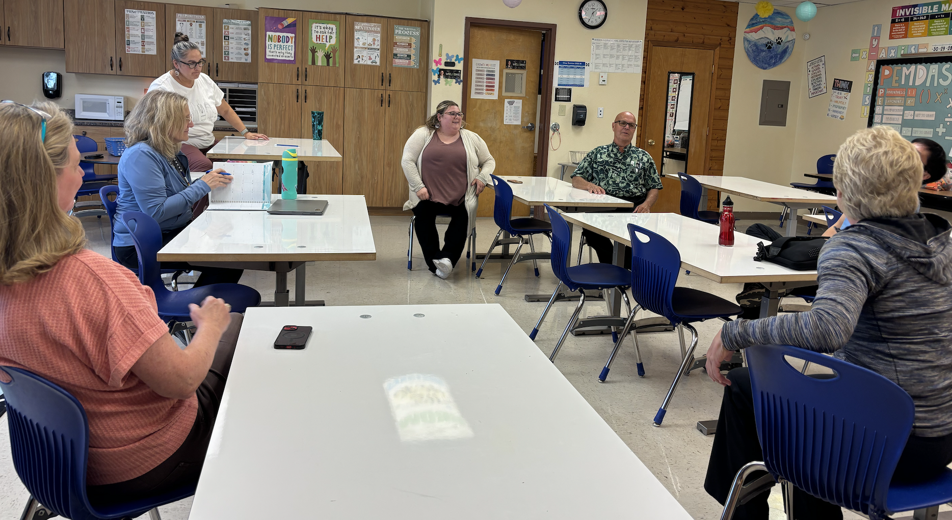
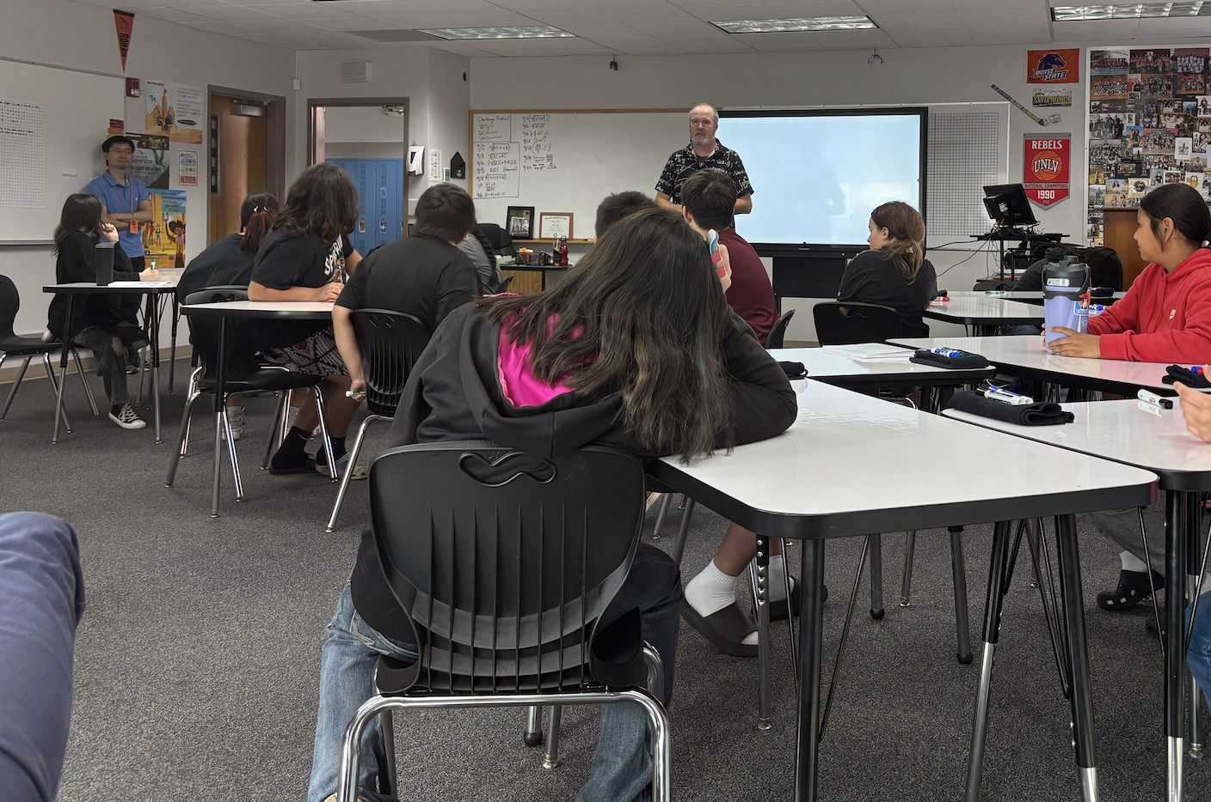
Networking
  Smaller, discipline- or grade-level breakout groups (e.g., math vs. science, middle vs. high school)?
  Regional subgroups for nearby schools (e.g., Hardin, Lame Deer, Colstrip)?
  Subgroup leaders?

Slide 25
What other evidences may MSU Noyce MTF program collect and measure?
1. Lead a STEM extracurricular activity (e.g., FIRST Robotics Competition, Science Fair, Science Olympiad, MathCounts, community STEM day)
2. Increase STEM achievement scores for All Students
3. Develop and implement a culturally responsive STEM curriculum
4. Provide a STEM PD workshop (e.g., SSI, MFPE, MCubed speaker, OPI Learning Hub leader)
5….

Slide 26

Resource Development
Create a centralized database of:
  Lesson plans, IEFA-integrated activities, and STEM resources.
  Recorded presentations and conference materials.
  Articles and research relevant to rural and Indigenous education.
Ensure resources remain accessible beyond the grant period.
?

Slide 27
Canvas Navigation
I struggled with Canvas navigation and need a “cheat sheet” or tutorial.

Slide 28
Q & A
1. Are Noyce participants responsible for travel expenses?
MSU's Noyce program will support fellows for MSU housing, meals, and registration fees in attending the joint meeting of STEM Summer Institute Annual STEM Leadership Academy from summer 2025 to summer 2029 and two out-of-state Noyce meetings MSU's Noyce program may not be able to support other PD travel expenses. Fellows may need to use their Noyce stipends to cover additional travel.
2. Can online meetings be used to take the place of in-person visits?
No.
3.

