Slide 1
Welcome to Faculty Senate!
Colter Ellis
Faculty Senate Chair
Associate Professor of Sociology
Stephanie McCalla
Faculty Senate Chair-Elect
Chemical & Biological Engineering

Slide 2
Gentle Reminders
Faculty Senate is an open and public meeting
Please, only Senators speak in the meeting, unless you are specifically called on by the Chair or Chair-elect to speak
Public may address the Senate at end of the meeting during public comment

Slide 3
Approval of FS Minutes from August 30, 2023
Do I have a motion to approve?
Any Discussion?
All those in favor of the motion indicate by saying aye
Those not in favor of the motion indicate by same sign

Slide 4
FYI Items
Fran Albrecht has been selected President/CEO of MSUAF and VP for Advancement of Montana State University, effective November 1, 2023.
The Office of Research Compliance will host the Research Integrity & Compliance Conference 2023 on Wednesday and Thursday, Oct. 18-19 in the SUB Ballrooms and invites you to join.

Slide 5
FYI Items
Montana State University's fall enrollment is the largest in its 130-year history, with 16,978 students pursuing the many benefits of higher education at the state's largest university. The new enrollment is up 2% over last fall's headcount, an increase of 290 students.
Lunch with the President and Provost
    There is still space available. Please email jtobin@montana.edu to be added to the list!
      Monday, October 23 - - 12-1pm
      Tuesday, November 28 - - 12-1pm

Slide 6
Information Updates
Tracy Ellig: Updated Social Media Policy
Megan Lasso: MSU Operating Budget Snapshot

Slide 7

FY24 Operating Budget Snapshot
Faculty Senate
September 2023

Slide 8
Presentation Overview
Funding sources
Revenue Overview and Metrics
Expenditure overview by program and category
Discounting and net revenue impacts
https://www.mus.edu/data/operating_budgets/OperatingBudgets.html

Slide 9

Fund Overview
Current Unrestricted
Auxiliary
Designated
Ticket Sales, Testing Svcs, Fees
Tuition and State Funds
Room and Board
Restricted
Plant
Grants and Donors
Capital Project, Mand Fees

Slide 10
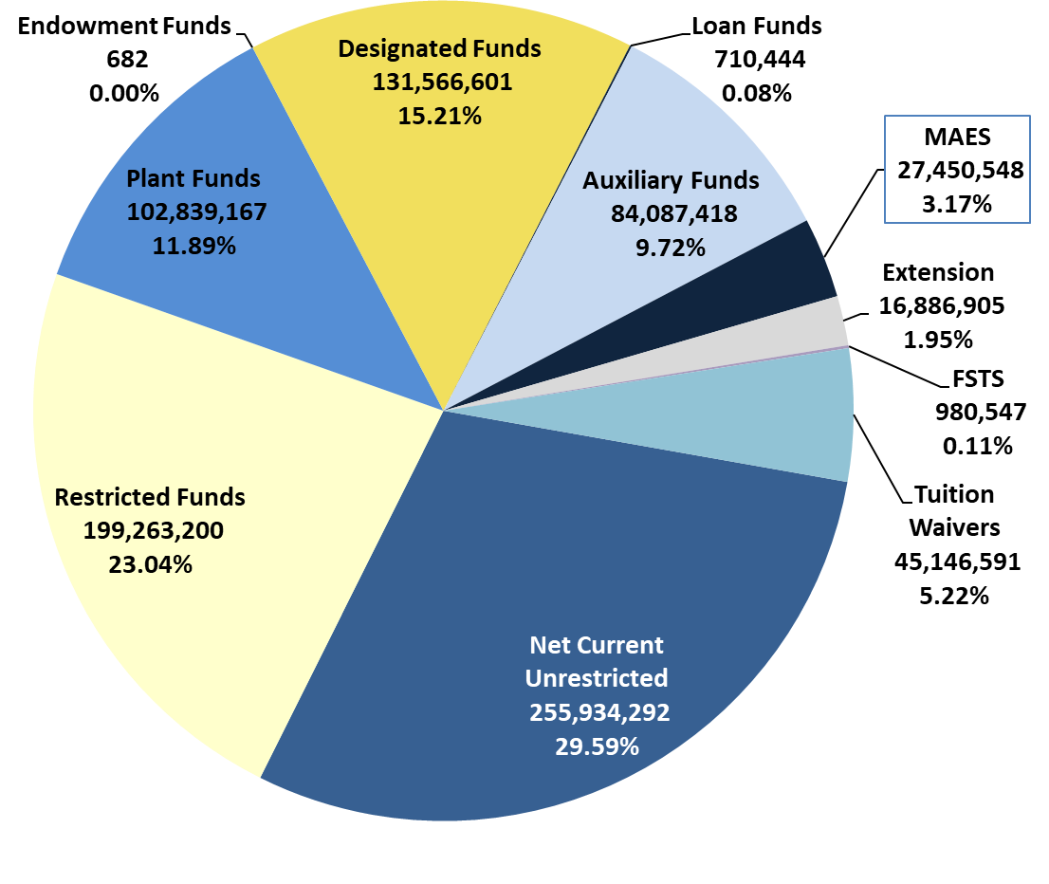
MSU and Agencies Total Revenue
FY23 Actual
Total Revenue = $864,866,395

Slide 11
MSU Net Current Unrestricted
5-year Revenue Key Metrics
State % share of total net revenue is consistent over time
State support per Resident FTE is impacted by both increased state appropriation and declining Resident FTE
System-wide, the state support per Resident FTE is $11,426
Net tuition per FTE is a key metric in decision-making for our financial health

Slide 12
MSU Net Current Unrestricted
5-year Historical Metrics
Key Metric is the % of total expenditures in indexes identified as instruction
Additionally, the % of total expenditures in indexes identified as instruction, academic support, and student services

Slide 13
MSU Discounts and Enrollment
5-year Historical
BOR Designated discounts are required by board policy and, if an individual meets the criteria, qualifies for the discount
Our approach to non-resident discounting is strategic and projected over time to determine financial impacts

Slide 14
Questions

Slide 16
Undergraduate Courses and Programs
Courses—First Reading
    BMIS 312 : Data Analytics II
    HDFS 468 : Home Visiting for Families
    HLD 346 : The Leader's Way: Deep Listening, Systems & Processes

Slide 17
Undergraduate Courses and Programs
Course Changes — First Reading
  LS 499R :Senior Capstone
    Change in title from
    Credit change
Courses—Second Reading
    CSTN 101 : Introduction to Concrete
    HSTR 405 : American Holy Land
    HSTR 469 : Memoir & Biography in History
Courses—Inactivations
  PHSX 405 : Special Relativity Online
    PHSX 405 was intended be replaced by PHSX 579.However, when PHSX 579 was approved in Spring 2023, PHSX 405 remained active.

Slide 18
Senate Open Discussion

Slide 19
Public Comment

Slide 20

Do I have a motion to adjourn?
Second?

